Slide 1
Diwali Sales
Exploratory Data Analysis (Using Python)

Slide 2
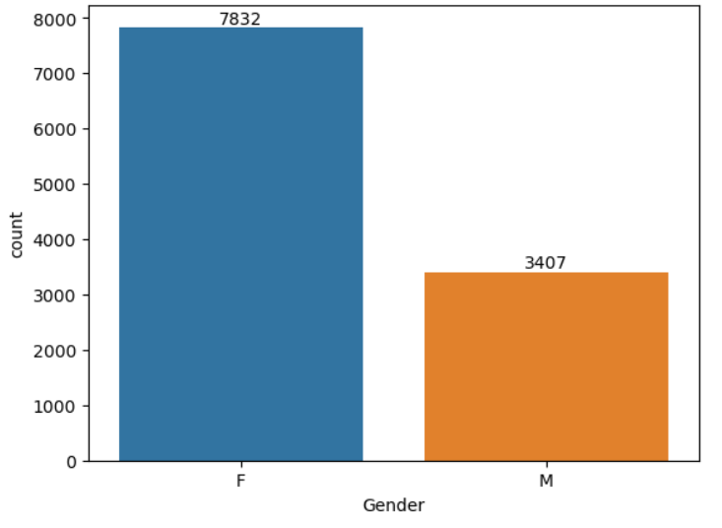
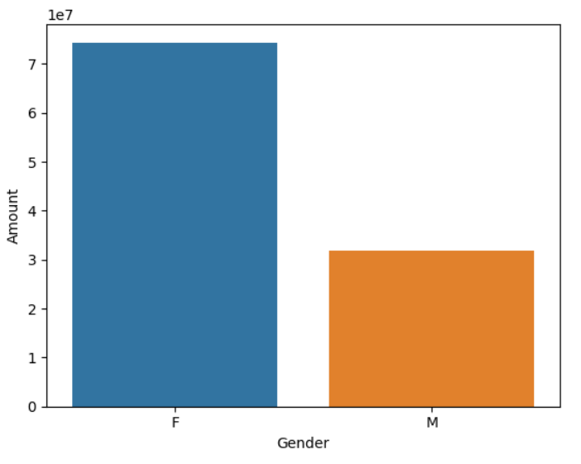
Gender Analysis
The following Bar graphs show that most of the orders done in the given data set is by female buyers.
The following Bar graphs show that the maximum amount spend by female buyers as per the given data set

Slide 3
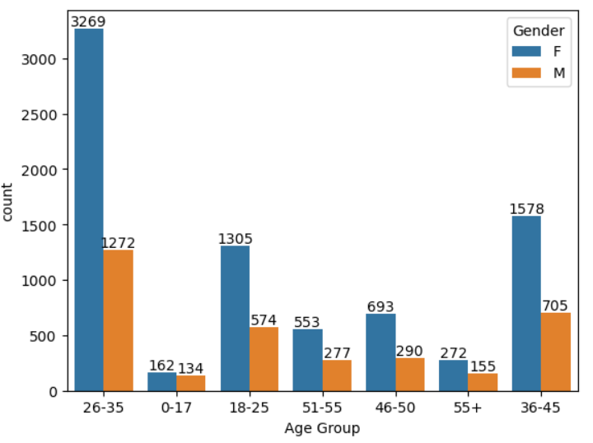
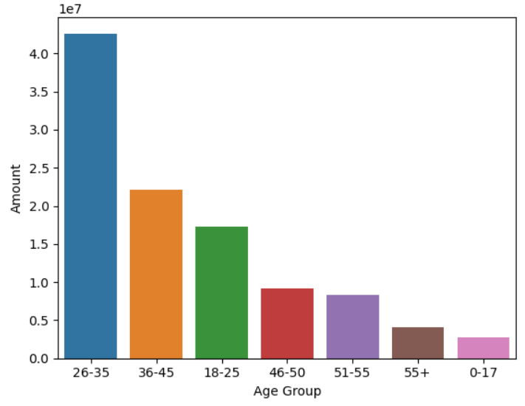
Age Analysis
As per the graph, the maximum orders came from female buyers have an age from 26-35 years old.
The maximum amount spend by the buyers is done by the buyers in the age group 26-35 years old.

Slide 4
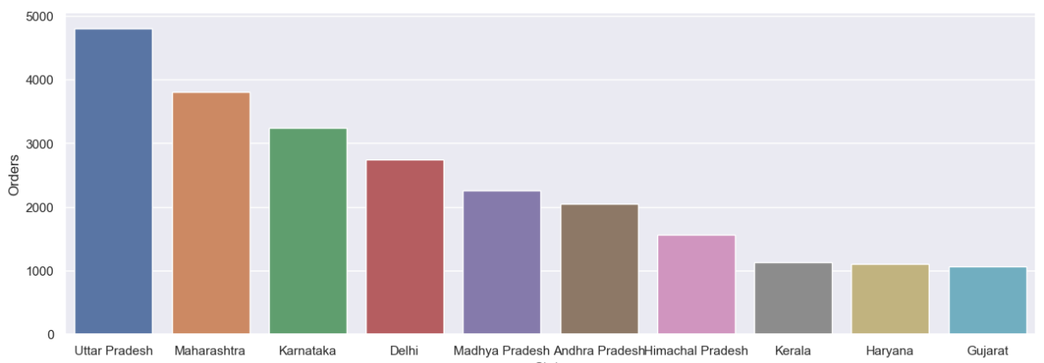
State Analysis
From the above graph we can see that the maximum number of orders from Uttar Pradesh, followed by Maharashtra, Karnataka and so on.

Slide 5
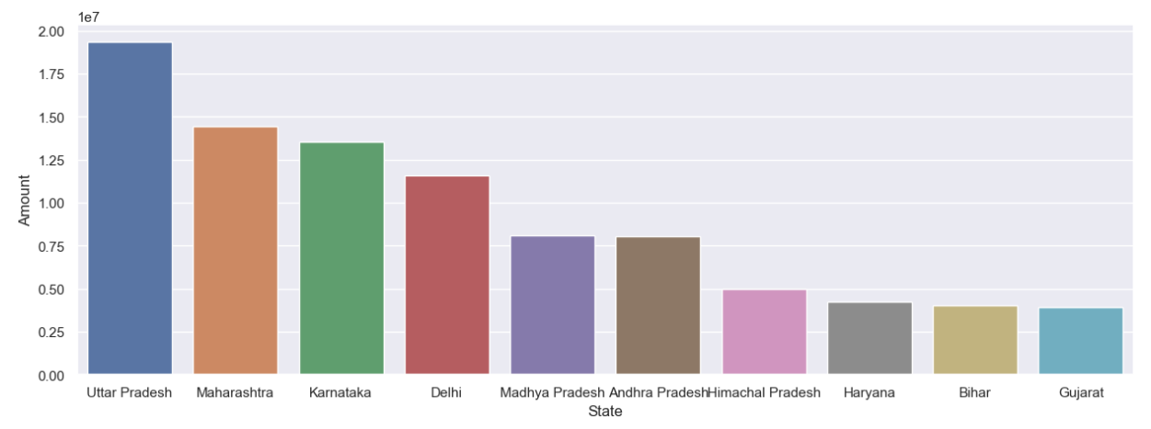
State Analysis
From the above graph we can see that the maximum amount spent is from Uttar Pradesh, followed by Maharashtra, Karnataka and so on.

Slide 6
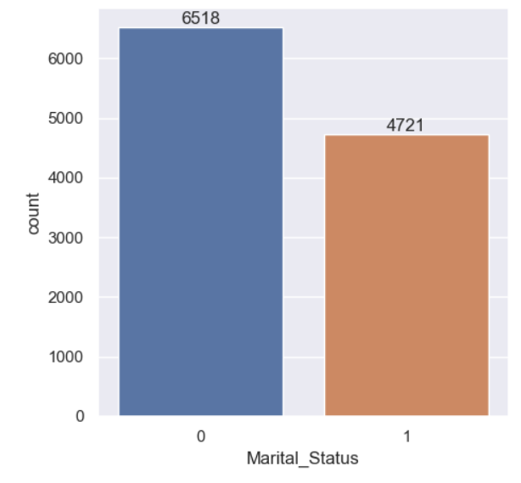
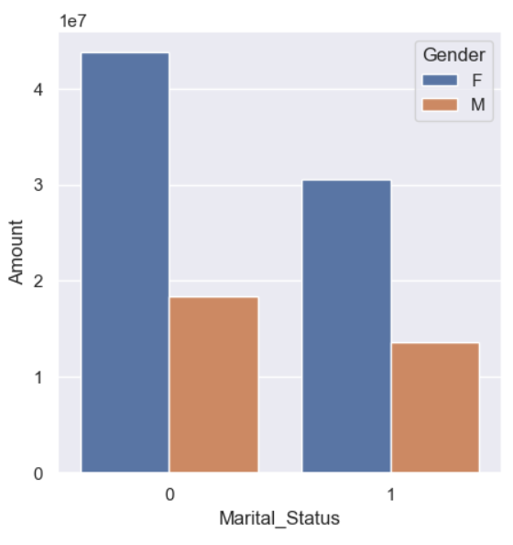
Marital Status Analysis
From the above graph we can see that most of the orders are placed by buyers who married.
The above graph shows most of the buyers are female who are married.

Slide 7
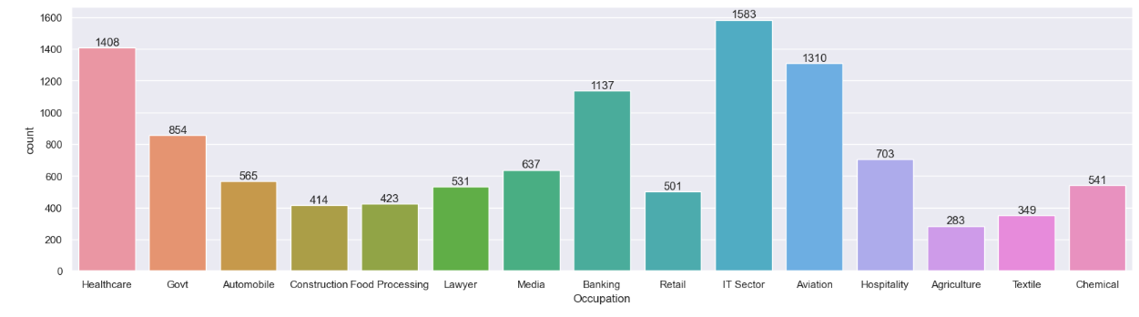
Occupation Analysis
From the above graphs we can see that the maximum orders were made by the people working in the IT Sector, Healthcare, and Aviation sector.

Slide 8
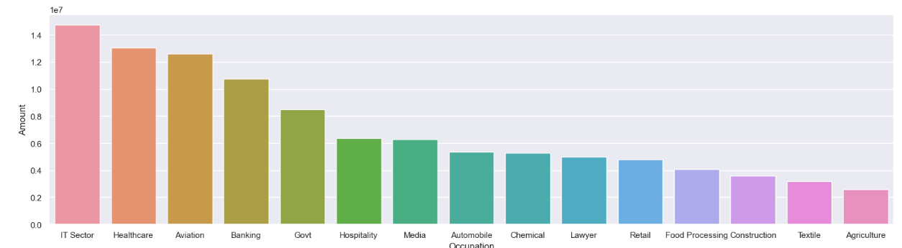
Occupation Analysis
From the above graphs we can see that the maximum orders were made by the people working in the IT Sector, Healthcare, and Aviation sector.

Slide 9
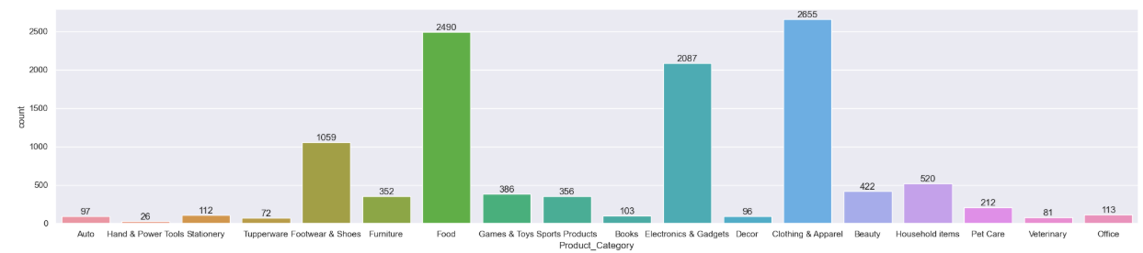
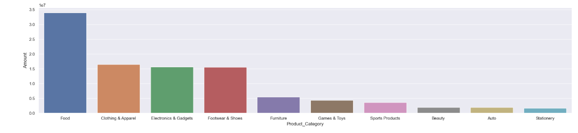
Product Analysis
From the above graph we can see that Clothing & Apparel, Food, and Electronic gadgets are the top 3 products sold.
Food is the product category where the spending is maximum, followed by Clothing & Apparel and Electronic gadgets.

Slide 10

Conclusion
Diwali sales data reveals married women aged 26-35, working in IT, healthcare, and aviation in UP, Maharashtra, and Karnataka, are the highest spenders. Their purchasing power is concentrated in food, clothing, and electronics. This demographic's high spending stems from combined incomes, career stability, and cultural festive traditions. Targeted marketing and optimized inventory for these product categories are crucial. The data reflects economic growth in these sectors and regions, alongside the increasing adoption of technology and e-commerce. Cultural significance drives spending on traditional items like food and clothing during Diwali.

